Slide 1
Staj Sunum
Candan Büyükköşker

Slide 2
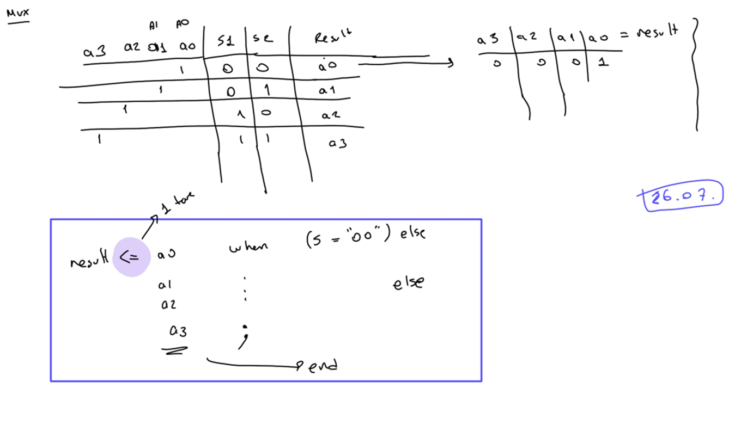
4x1 MUX

Slide 3
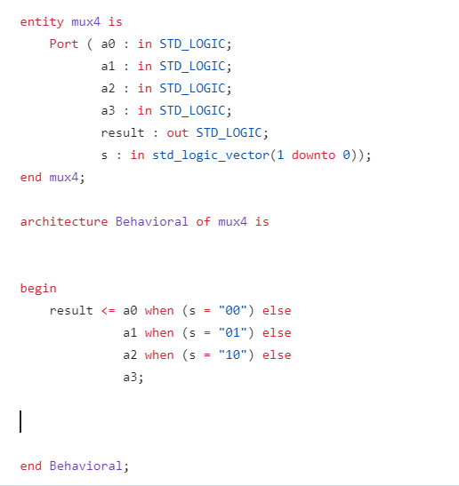
4x1 MUX

Slide 4
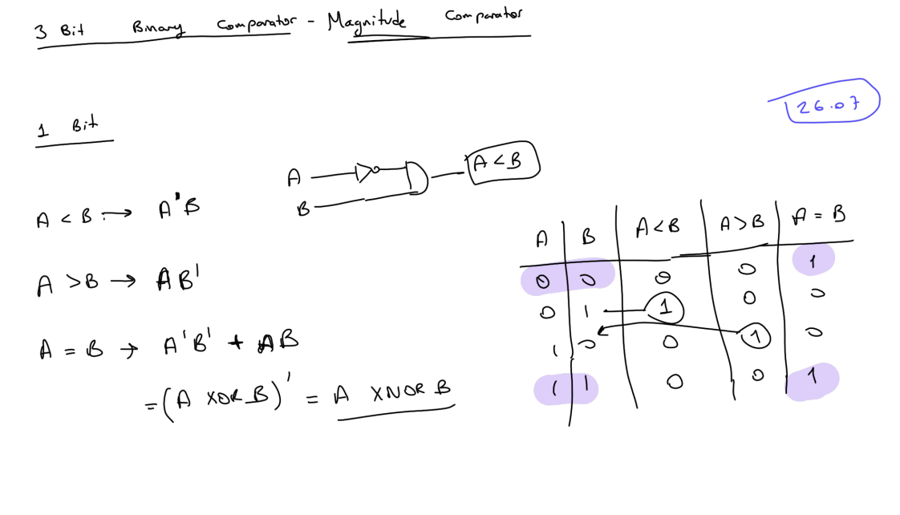
3 Bit Binary Comparator

Slide 5
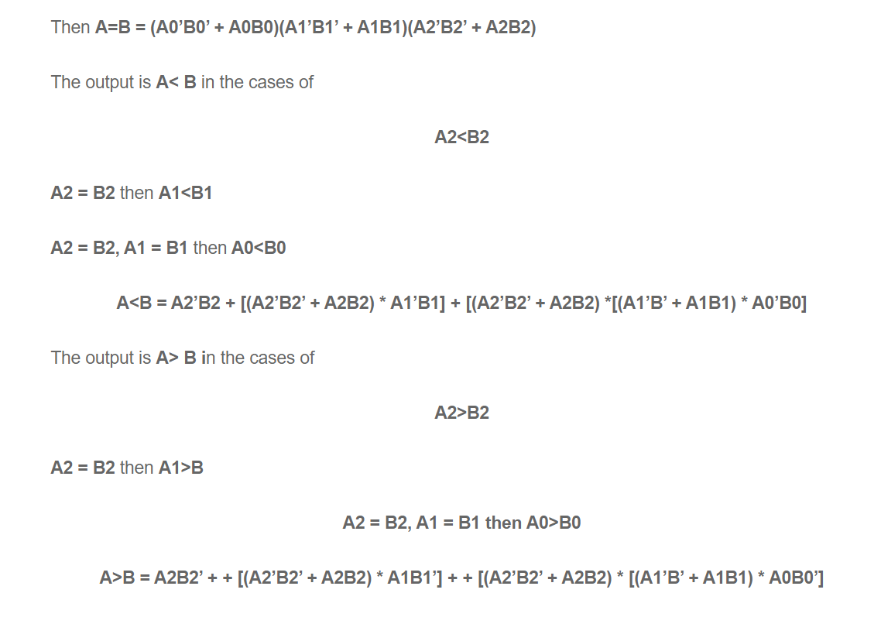
3 Bit Binary Comparator

Slide 6
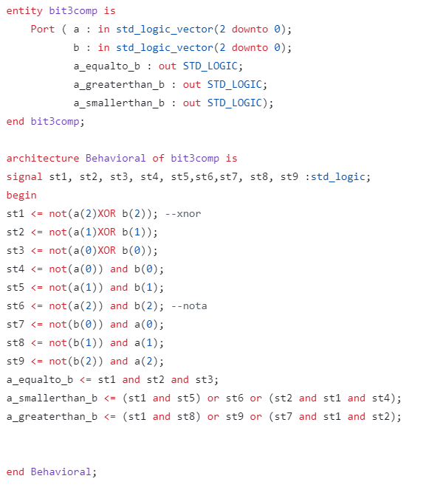
3 Bit Binary Comparator
library IEEE;
use IEEE.STD_LOGIC_1164.ALL;
use IEEE.NUMERIC_STD.ALL;
entity comparator_3bit is
Port (
a : in STD_LOGIC_VECTOR(2 downto 0);
b : in STD_LOGIC_VECTOR(2 downto 0);
a_gt_b : out STD_LOGIC;
a_lt_b : out STD_LOGIC;
a_eq_b : out STD_LOGIC
);
end comparator_3bit;
architecture Behavioral of comparator_3bit is
begin
process(a, b)
begin
if a > b then
a_gt_b <= '1';
a_lt_b <= '0';
a_eq_b <= '0';
elsif a < b then
a_gt_b <= '0';
a_lt_b <= '1';
a_eq_b <= '0';
else
a_gt_b <= '0';
a_lt_b <= '0';
a_eq_b <= '1';
end if;
end process;
end Behavioral;

Slide 7
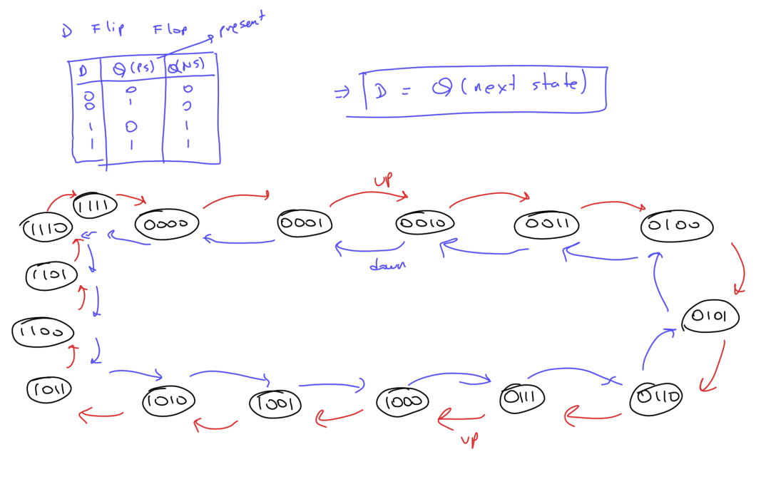
Up-Down Counter Logic

Slide 8
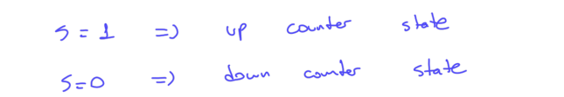
Bidirectional (up-down) 4 bit counter
library IEEE;
use IEEE.STD_LOGIC_1164.ALL;
use IEEE.STD_LOGIC_ARITH.ALL;
use IEEE.STD_LOGIC_UNSIGNED.ALL;
entity UpDownCounter is
Port (
clk : in std_logic;
reset : in std_logic;
up_down : in std_logic; -- Control signal: '1' for up, '0' for down
count : out std_logic_vector(3 downto 0) -- 4-bit counter
);
end UpDownCounter;
architecture Behavioral of UpDownCounter is
signal counter : std_logic_vector(3 downto 0);
begin
process(clk, reset)
begin
if reset = '1' then
counter <= (others => '0');
elsif rising_edge(clk) then
if up_down = '1' then
counter <= counter + 1;
else
counter <= counter - 1;
end if;
end if;
end process;
count <= counter;
end Behavioral;

Slide 9
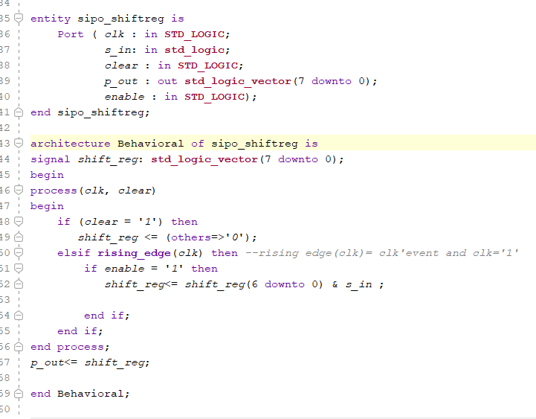
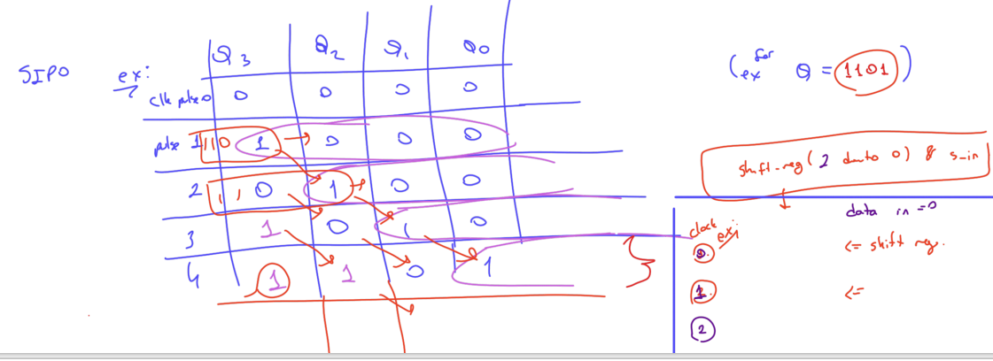
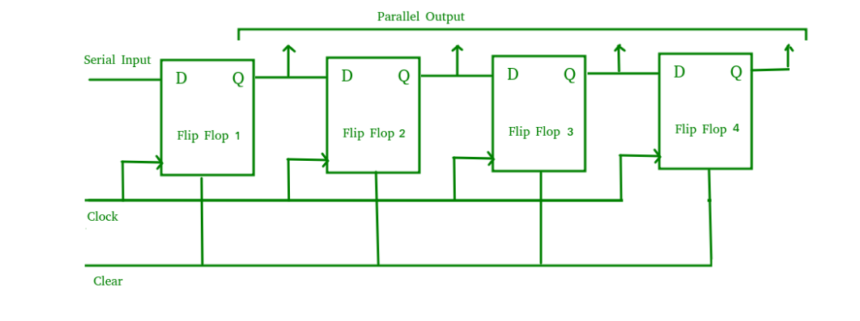
Serial in parallel out shift register

Slide 10
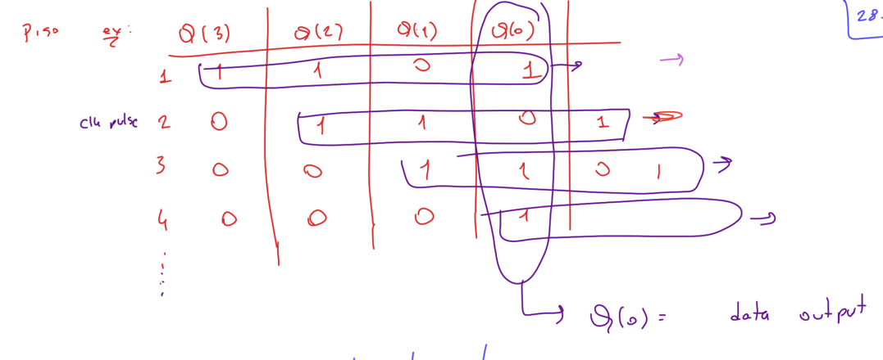
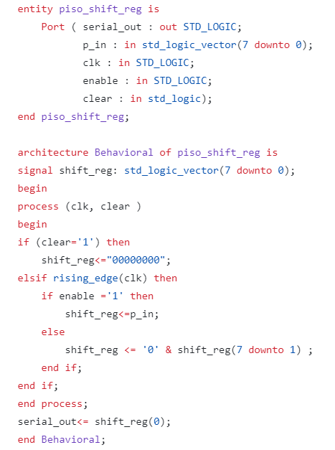
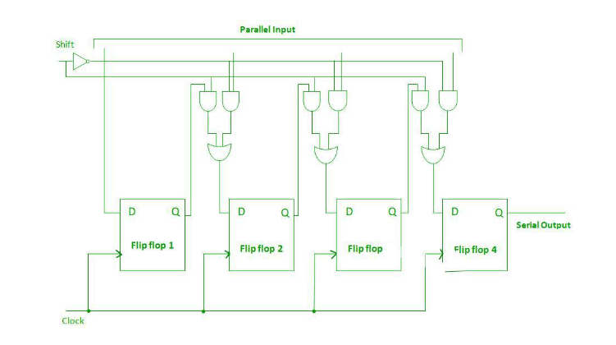
Parallel in serial out shift register

Slide 11
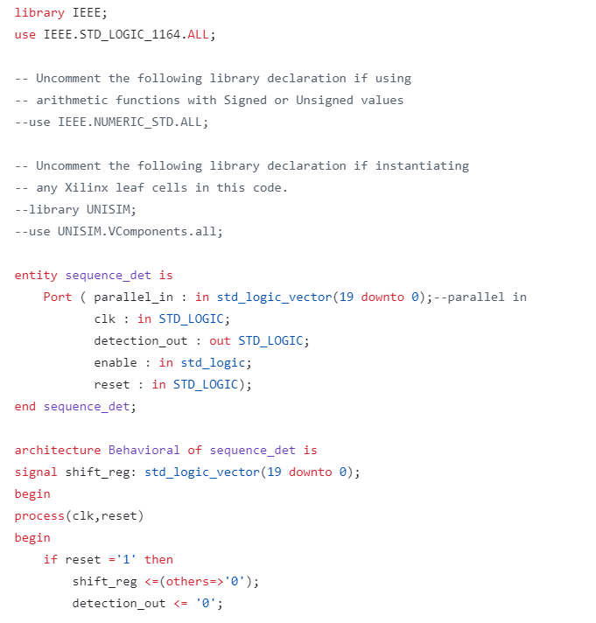
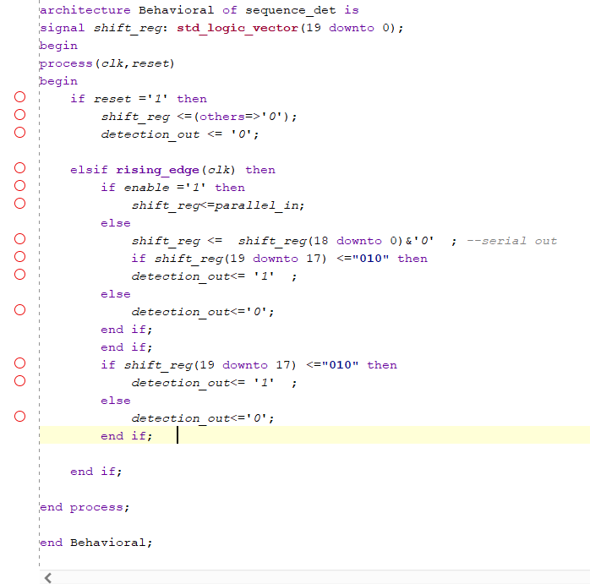
010 Overlapping Sequence detector in 20 bit data-sola kaydırma ile

Slide 12
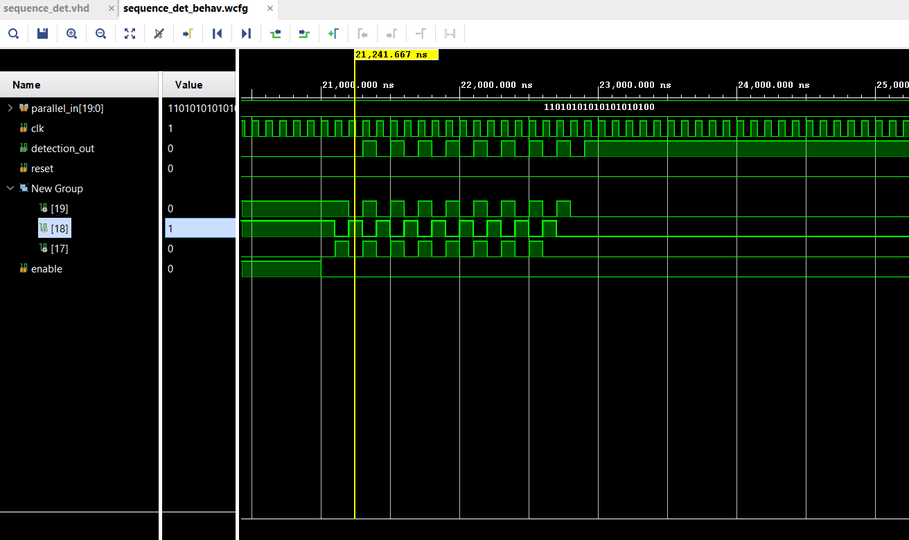
010 Overlapping Sequence detector -Simulation

Slide 13
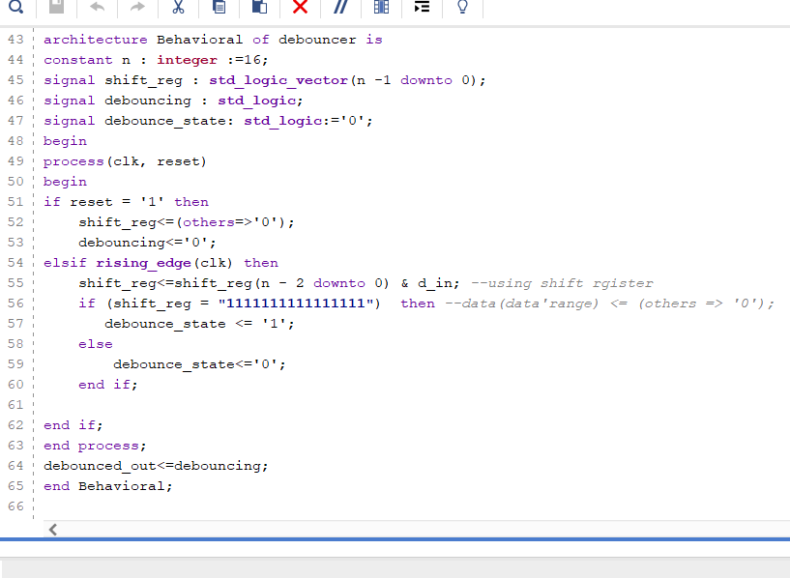
Debouncer Circuit-1

Slide 14
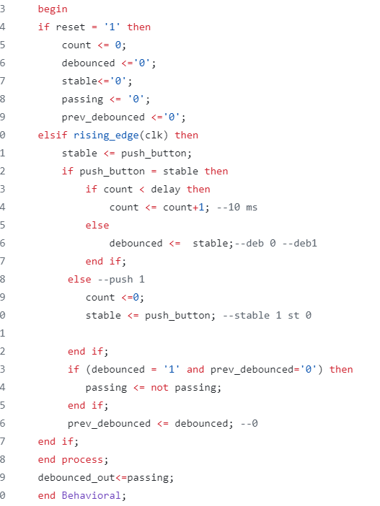
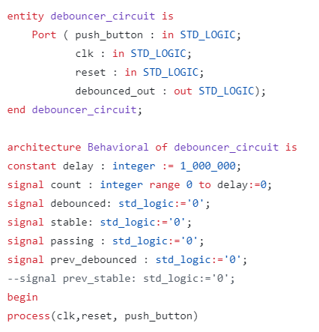
Debouncer Circuit-2
Push button’ın o anki durumu stable’a eşit ve push button 10 ms boyunca sabit(stable’a eşit) ise stabil sayılır ve debounced stable’a eşitlenir,debounced 0dan 1e geçerken debounced_out’un 1 kalması için passing kendi değiline eşitlenir.

Slide 15
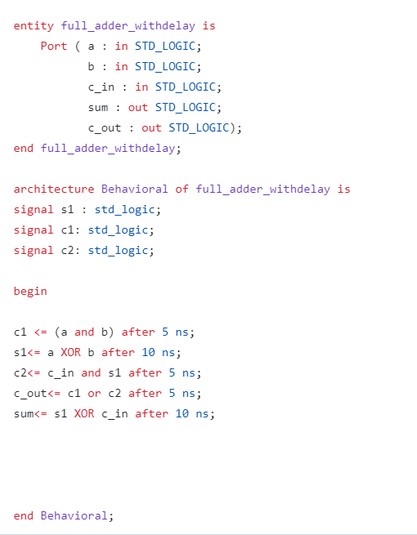
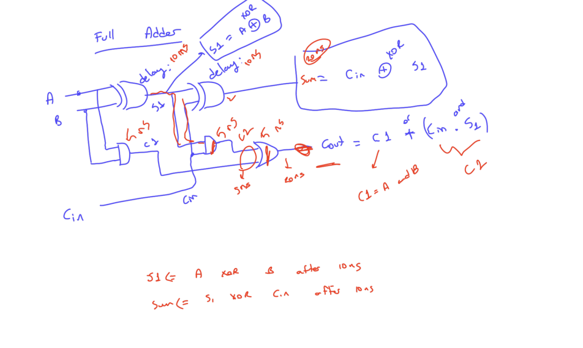
Full Adder

Slide 16
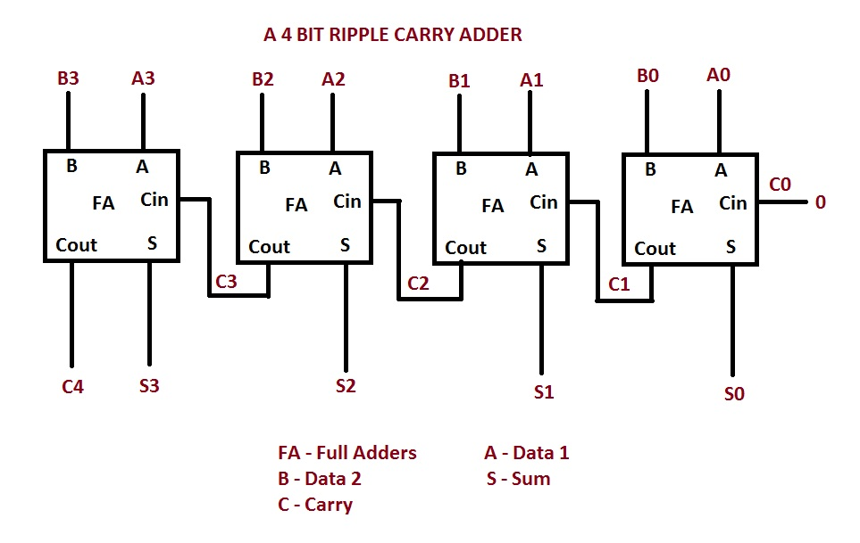
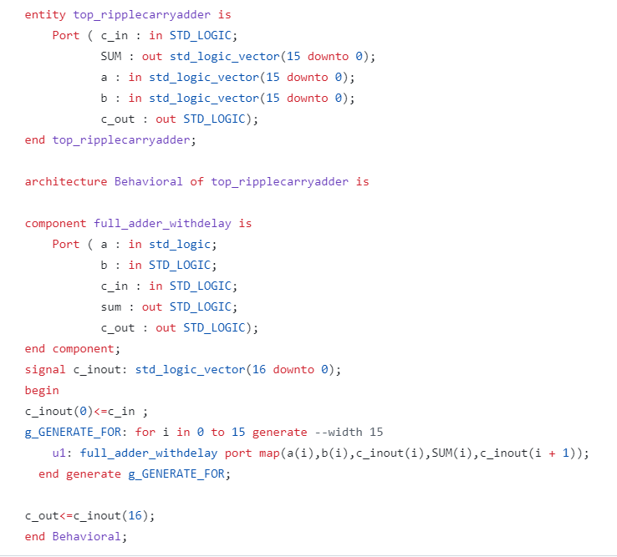
Ripple Carry Adder

Slide 17
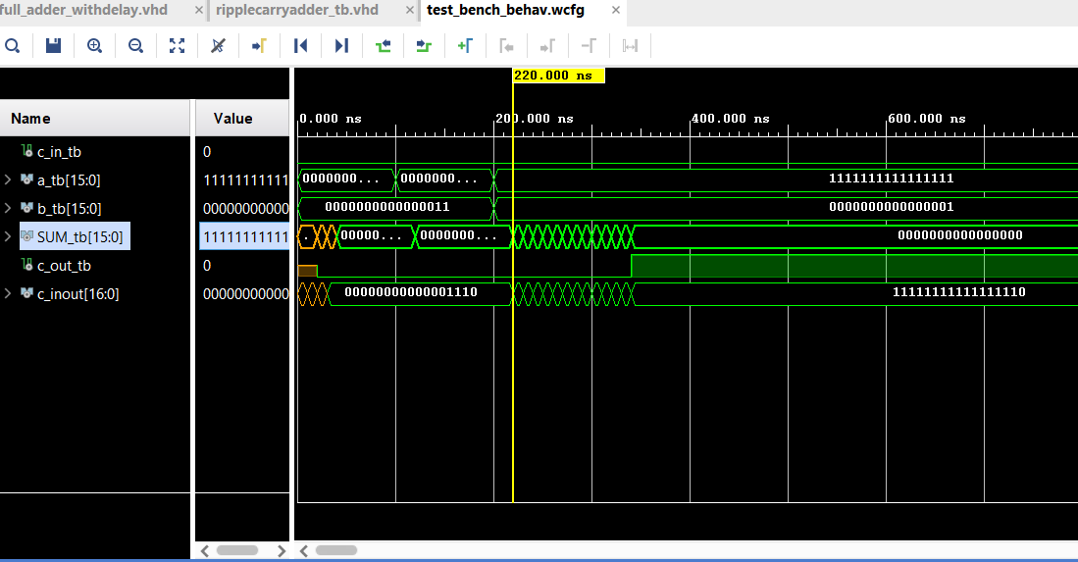
Ripple Carry Adder-Simulation

Slide 18
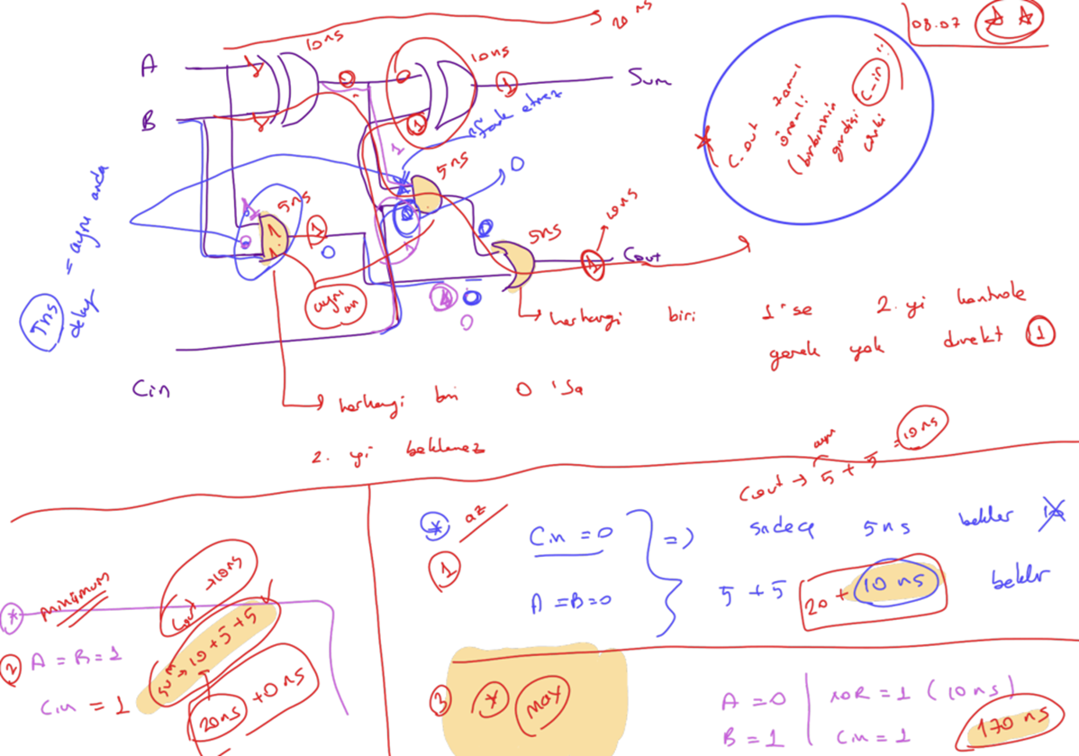
Ripple Carry Adder- different delay

Slide 19
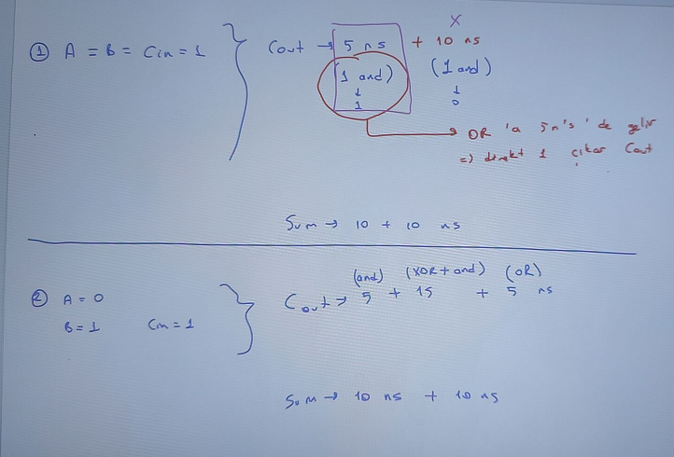
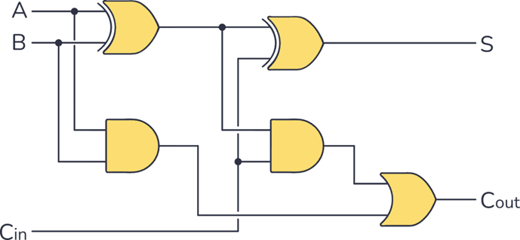
Ripple Carry Adder- different delay

Slide 20
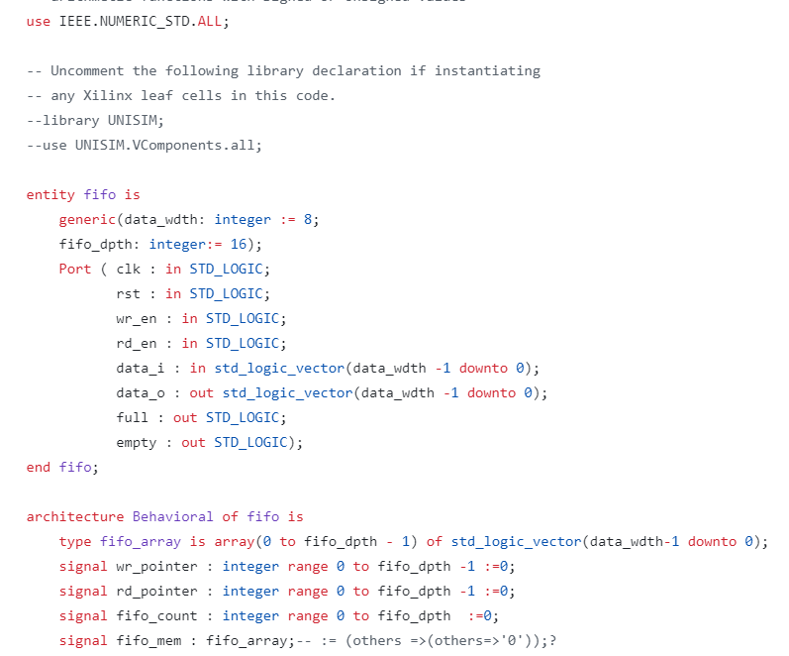
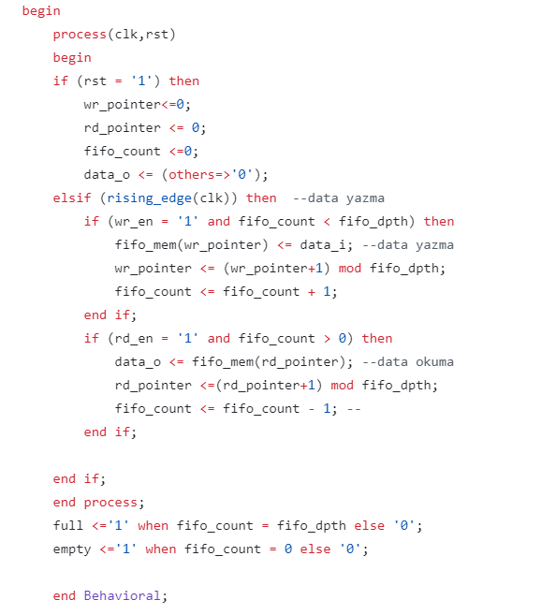
FIFO design

Slide 21
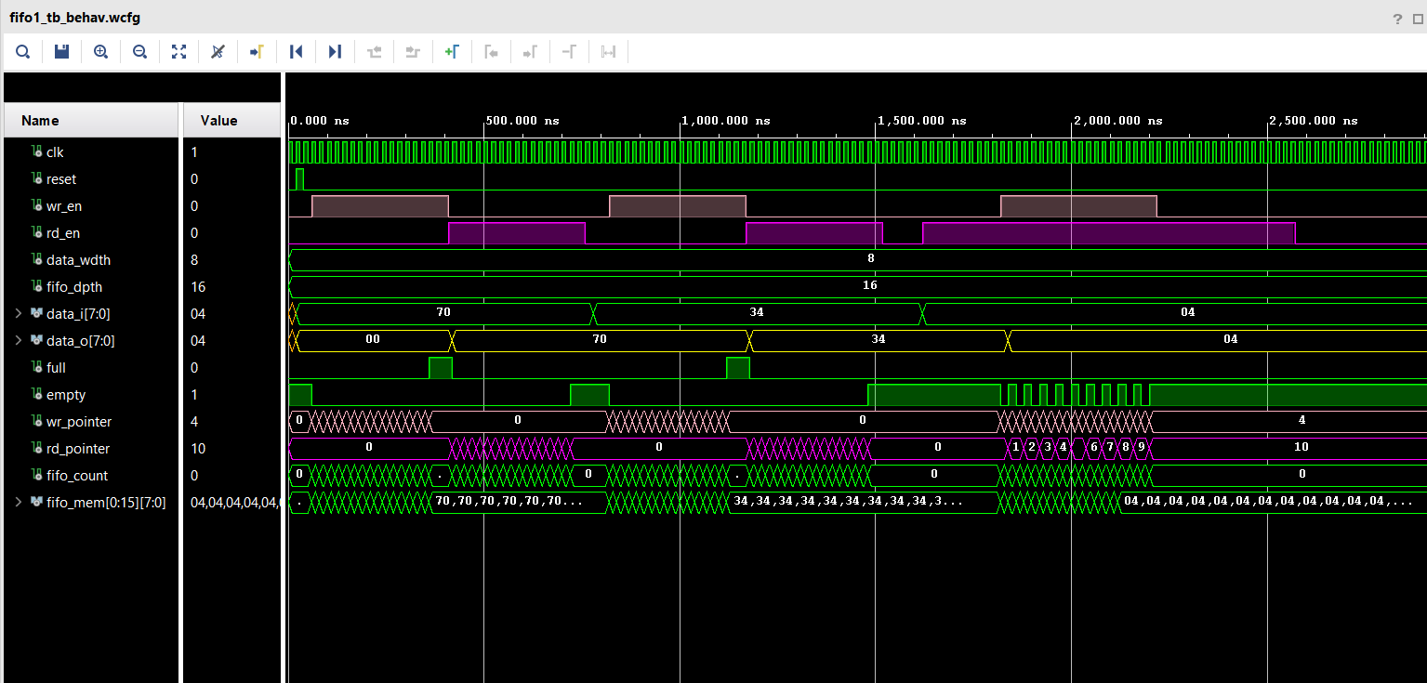
FIFO Simulation

Slide 22
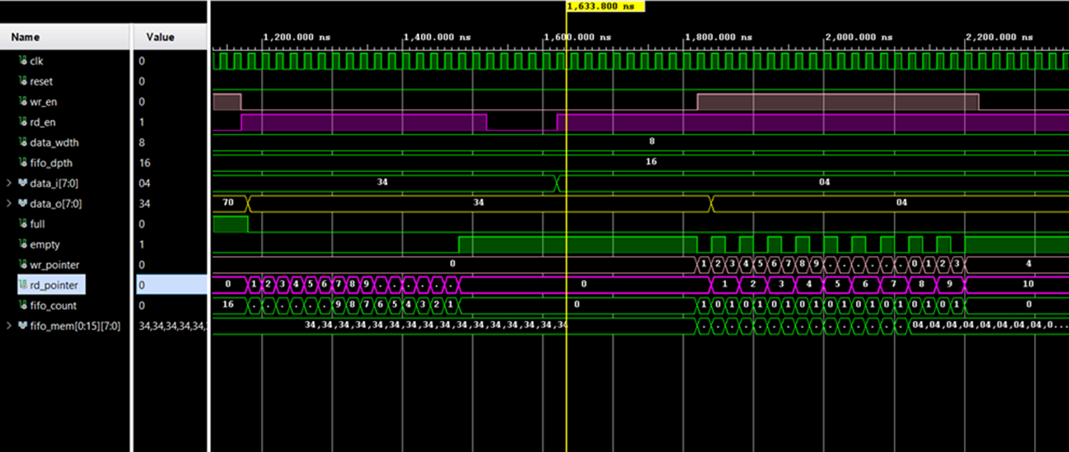
FIFO wr_pointer rd_pointer

Slide 23
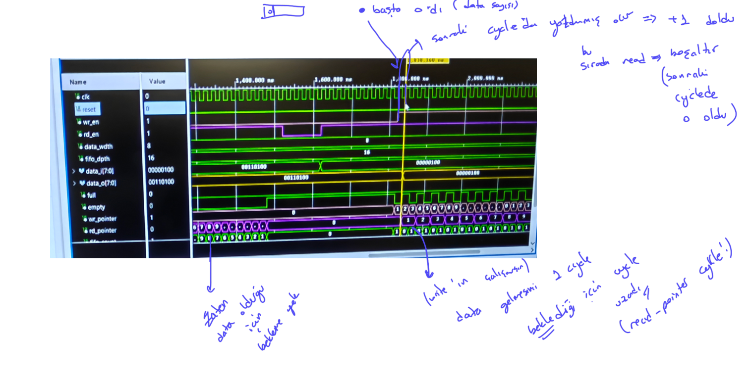
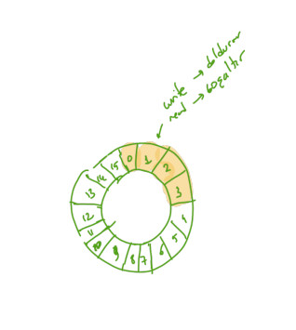
FIFO Structure and Simulation

Slide 24
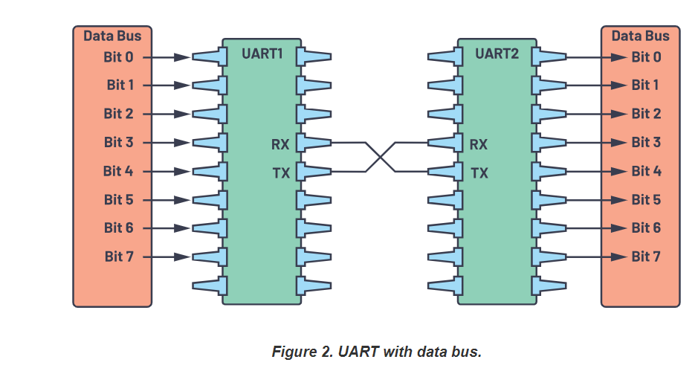
UART Module

Slide 25
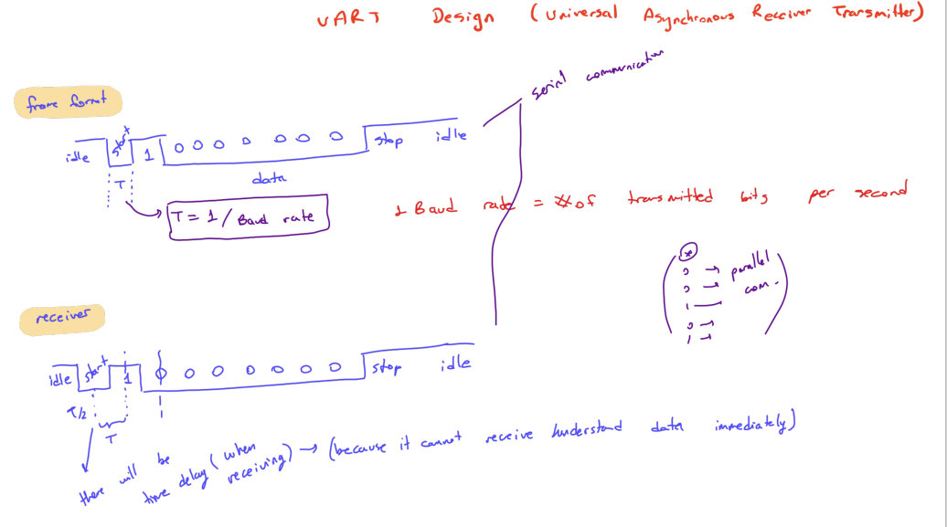
UART

Slide 26
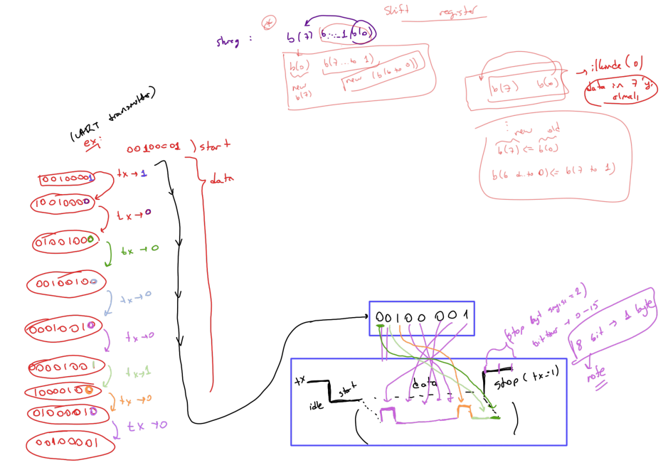
UART Transmitter TX

Slide 27
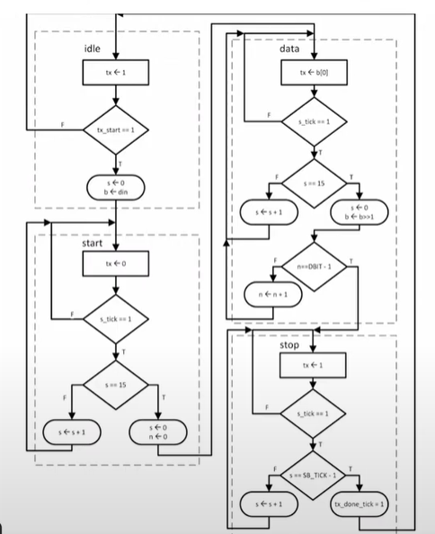
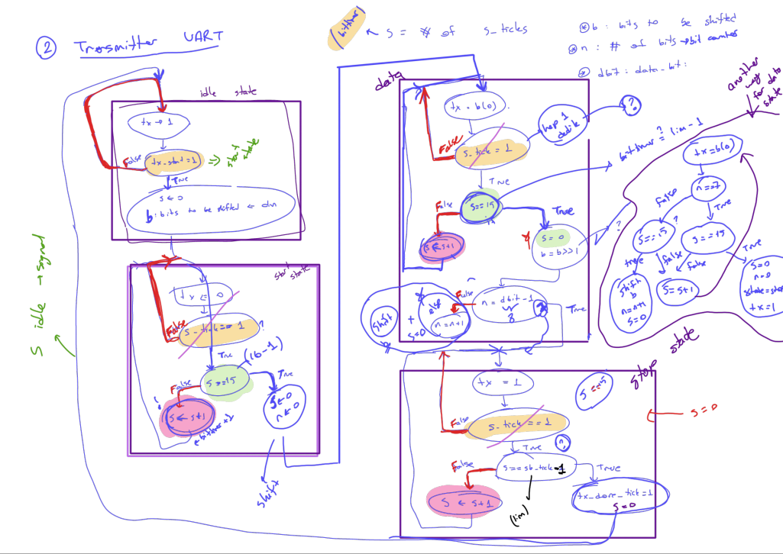
UART Transmitter TX

Slide 28
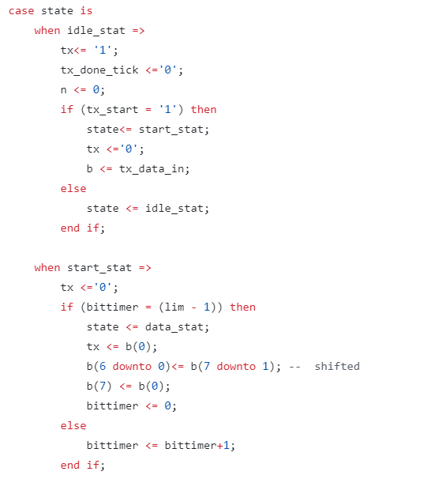
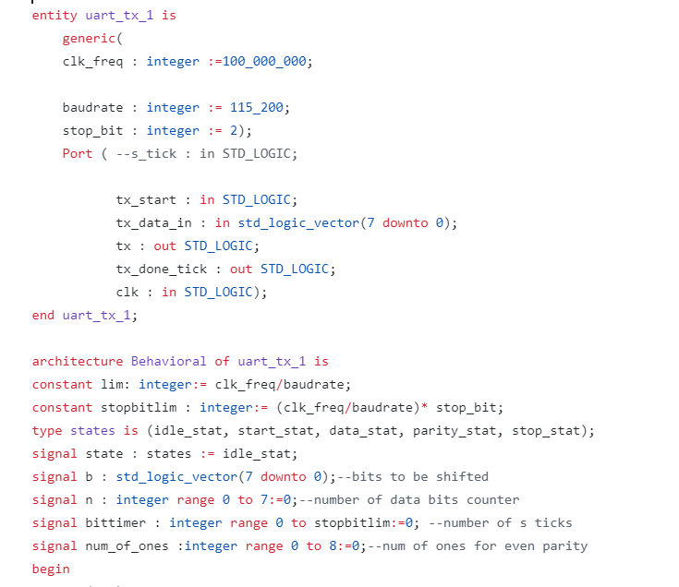
UART TX code

Slide 29
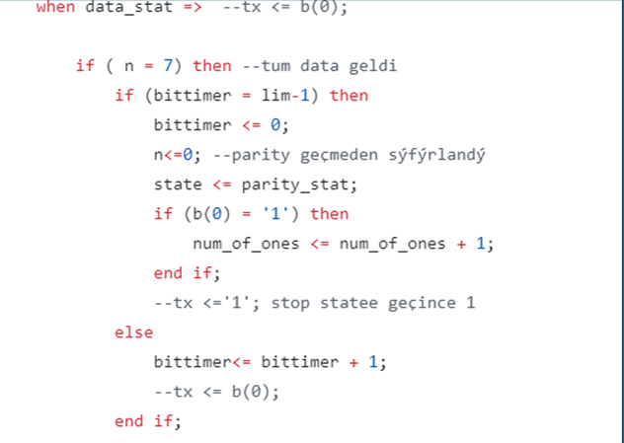
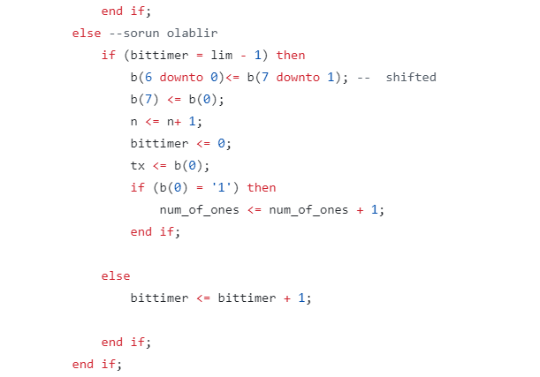
UART TX

Slide 30
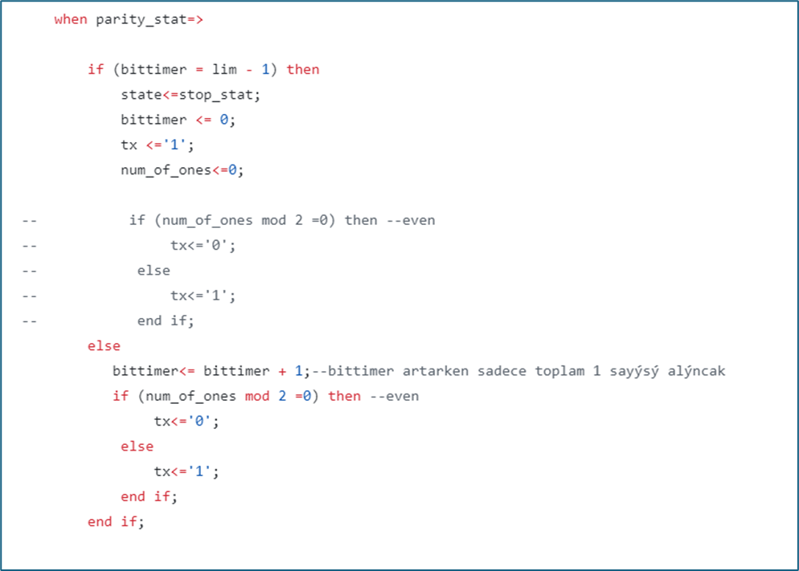
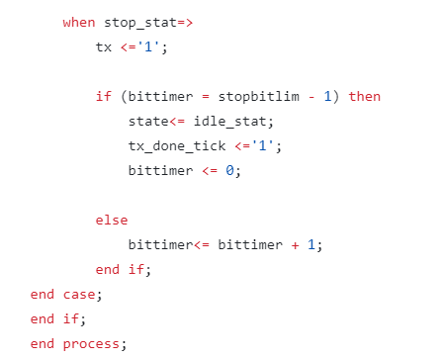
UART TX

Slide 31
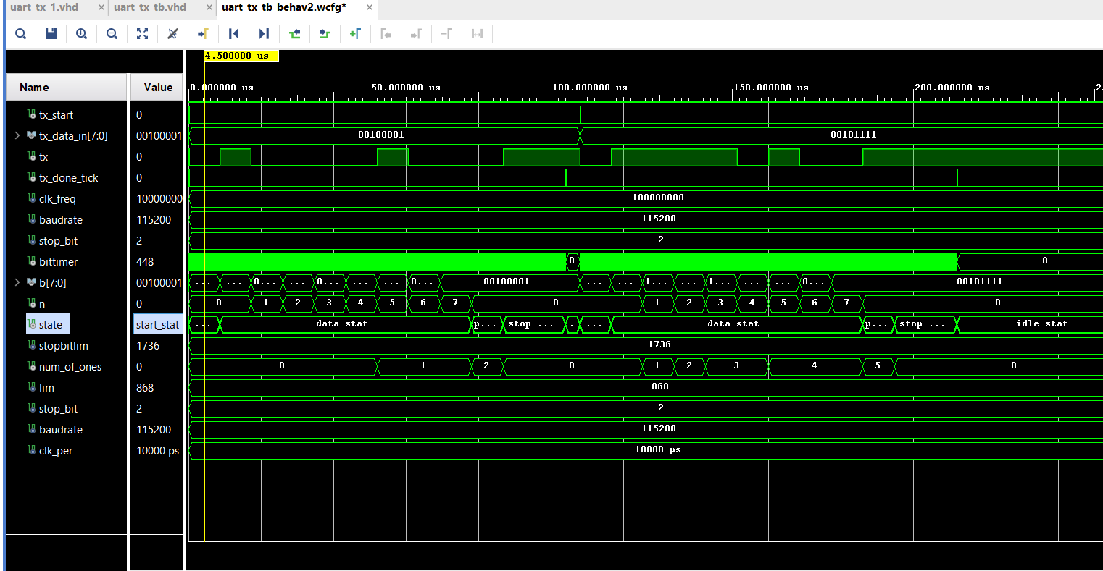
UART TX Simulation

Slide 32
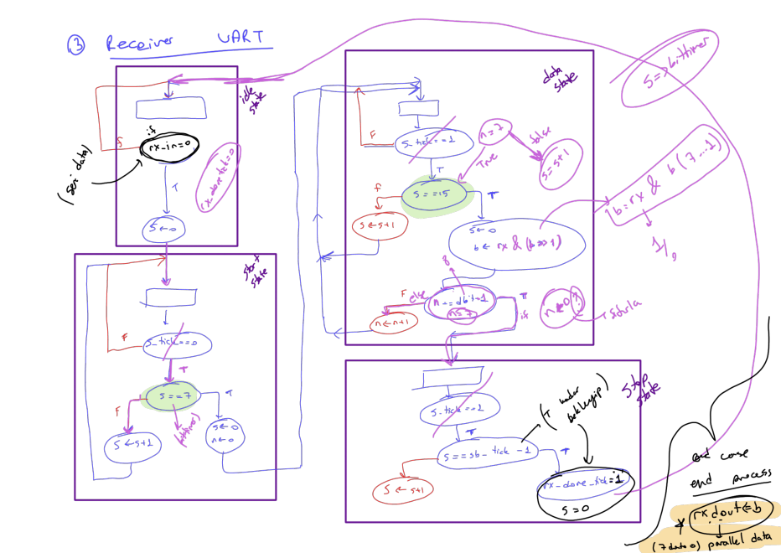
UART Receiver RX

Slide 33
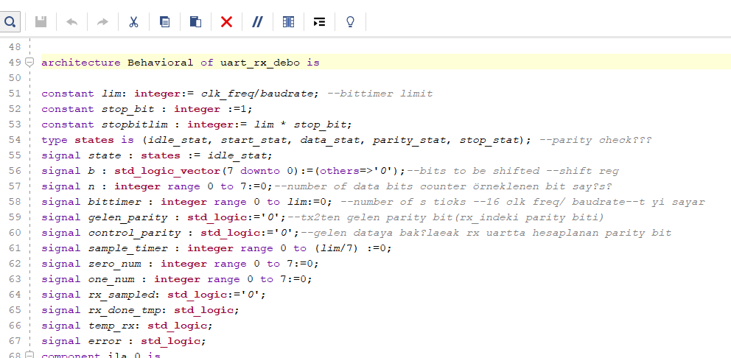
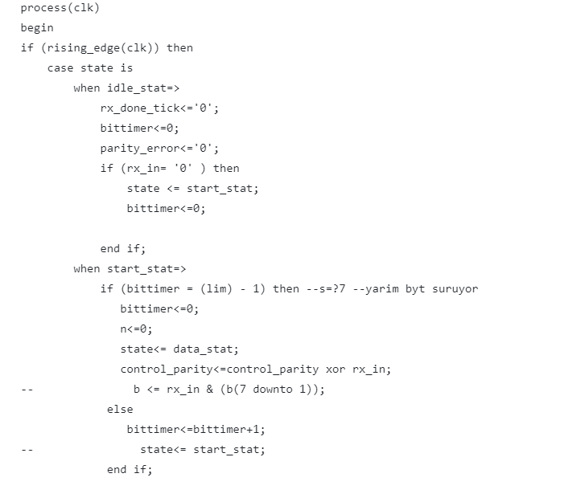
UART RX

Slide 34
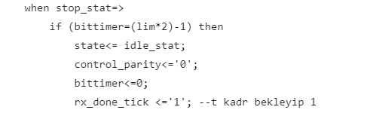
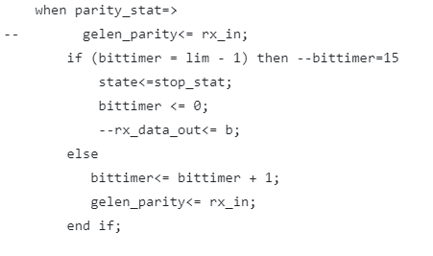

UART RX

Slide 35

UART RX

Slide 36


UART RX

Slide 37

UART RX simulation

Slide 38

Tx- Rx top design

Slide 39

Project Top Design

Slide 40

Top Design code

Slide 41

Top Design

Slide 42


ILA-rx
Integrated Logic Analyzer (ILA) is a hardware debugging tool that is typically embedded within an FPGA design. It provides functionality similar to a logic analyzer, allowing you to monitor and capture internal signals, making it easier to debug and validate complex designs.

Slide 43



Slide 44


Vga

Slide 45

VGA renk oluşturma
Color Reproduction: By varying the intensity of the electron beams for each color phosphor (red, green, blue), the CRT can produce a full spectrum of colors. This is achieved through additive color mixing.

Slide 46

Vga connector
Zed board allows 12 bit color video output.
The RED (4 bits), GREEN (4 bits), and BLUE (4 bits) signals
control the pixel color;
– The 1-bit HSync (horizontal sync) and 1-bit VSync (vertical
sync) signals control the monitor refresh cycles.

Slide 47


Vga controller

Slide 48
Front back porch anlamı
Back Porch:
Definition: The back porch is a period of time between the end of the synchronization pulse and the start of the displayable area of a scanline (or frame).
Purpose: It allows the display circuitry to stabilize and prepare to start drawing the next line (or frame) of the image. The back porch ensures that the monitor has enough time to reset and get ready for the new line (or frame) data.
Front porch:The front porch provides a brief period after the end of the visible display area but before the start of the horizontal synchronization (Hsync) pulse. This delay allows the monitor's electron beam (in CRT monitors) or pixel processing (in modern LCDs) to stabilize and prepare for the next line of data.

Slide 49


Simulations

Slide 50

Overall simulation
V_count(dikey, y ) ve h_count(yatay, x)
Pixelleri sayar , yani her bir pixelin(x,y)
koordinatlarını belirler.
Burda v_count 0’ dan 524’e sayarken her bir v_count için h_count 0’dan 799’a
yani 1 sıra sayar. Sounda v_count 524’ saydığında tüm ekran taranmış olur.

Slide 51

TOP module

Slide 52

Text generator

Slide 53

Pipeline

Slide 54


Fpga yapısı
CLB- configurable logic block

